Slide 1
LEVERAGING DATA DEDUPLICATION TO IMPROVE
THEPERFORMANCE OF PRIMARY STORAGE SYSTEMS IN THE CLOUD
G.L.S. NARAYANI (136W1A0516)
K.V. TEJASWINI (136W1A0522)
S.DURGA SIRISHA (136W1A0544)
V.A.L.DURGA DEVI (136W1A0549)

Slide 2
OVERVIEW
ABSRTACT
SYSTEM ARCHITECTURE
INTRODUCTION
SYSTEM REQUIREMENTS
EXISTING SYSTEM
MODULES
DISADVANTAGES OF
EXISTING SYSTEM
SCREENSHOTS
CONCLUSION
PROPOSED SYSTEM
ADVANTAGES OF
PROPOSED SYSTEM
REFERENCE

Slide 3
ABSTRACT
With the explosive growth in data volume, the I/O bottleneck has
become an increasingly daunting challenge for big data analytics in
the Cloud . Moreover, directly applying data deduplication to primary
storage systems in the Cloud will likely cause space contention in
memory and data fragmentation on disks. Based on these observations,
we propose a performance-oriented I/O deduplication, called POD,
rather than a capacity-oriented I/O deduplication, exemplified by
iDedup, to improve the I/O performance of primary storage systems
in the Cloud without sacrificing capacity savings of the latter.

Slide 4
INTRODUCTION
Data deduplication has been demonstrated to be an
effective technique in Cloud backup and archiving
applications to reduce the backup window, improve the
storage-space efficiency and network bandwidth
utilization. The prototype of the POD scheme is
implemented as an embedded module at the
block-device level and a subfile deduplication approach
is used.

Slide 5
EXISTING SYSTEM
The existing data deduplication schemes for primary storage, such as
iDedup and Offline-Dedupe, are capacity oriented in that they focus
on storage capacity savings and only select the large requests to
deduplicate and bypass all the small requests
(e.g., 4 KB, 8 KB or less).
However, previous workload studies have revealed that small files
dominate in primary storage systems (more than 50 percent) and are
at the root of the system performance bottleneck.

Slide 6
DISADVANTAGES OF EXISTING SYSTEM
From a performance perspective, the existing data deduplication
schemes fail to consider these workload characteristics in
primary storage systems, missing the opportunity to address one
of the most important issues in primary storage, that of performance.
This fragmentation of data can cause a subsequent read request to
invoke many, ften random, disk I/O operations, leading to
performance degradation.

Slide 7
PROPOSED SYSTEM
To address the important performance issue of primary storage in the
Cloud, and the above deduplication-induced problems, we propose
Performance-Oriented data Deduplication scheme, called POD,
rather than a capacity-oriented one (e.g., iDedup), to improve the
I/O performance of primary storage systems in the Cloud by
considering the workload characteristics.

Slide 8
ADVANTAGES OF PROSED SYSTEM
POD significantly improves the performance and saves capacity
of primary storage systems in the Cloud.

Slide 9
SYSTEM ARCHITECTURE

Slide 10
SYSTEM REQUIREMENTS
Hardware Requirements
Processor - Pentium –IV
Speed - 1.1 Ghz
RAM - 256 MB(min)
Hard Disk - 20 GB
Key Board - Standard Windows Keyboard
Mouse - Two or Three Button Mouse
Monitor - SVGA
Software Requirements
Operating System : Windows XP
Programming Language : JAVA/J2EE

Slide 11
MODULES
In this implementation we have 4 modules:
Data Deduplicator Module
Request Redirector Module
Access Monitor Module
Swap Module

Slide 12
Data Deduplicator:
The Data Deduplicator module is responsible for splitting the incoming write data
into data chunks, calculating the hash value of each data chunk, and identifying
whether a data chunk is redundant and popular.
Request Redirector:
Based on Data Deduplicator information, the Request Redirector module decides
whether the write request should be deduplicated, and maintains data consistency
to prevent the referenced data from being overwritten and updated.

Slide 13
Access Monitor:
The Access Monitor module is responsible for monitoring the intensity and
hit rate of the incoming read and write requests.
Swap:
Based on Access Monitor information, the Swap module dynamically adjusts
the cache space partition between the index cache and read cache.
Moreover, it swaps in/out the cached data from/to the back-end storage.

Slide 14
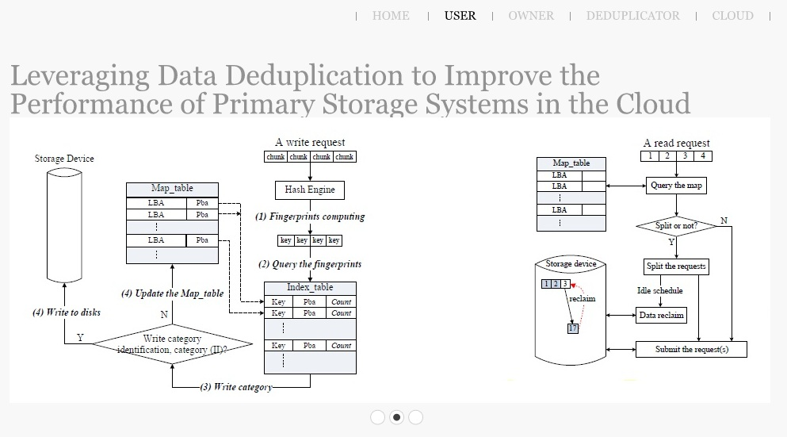
SCREENSHOTS

Slide 15
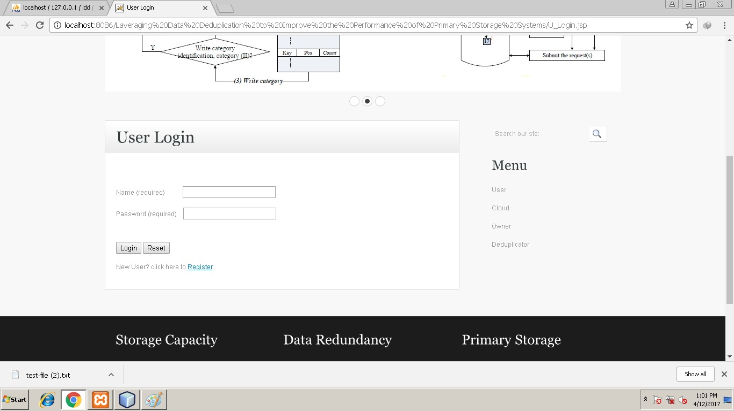

Slide 16
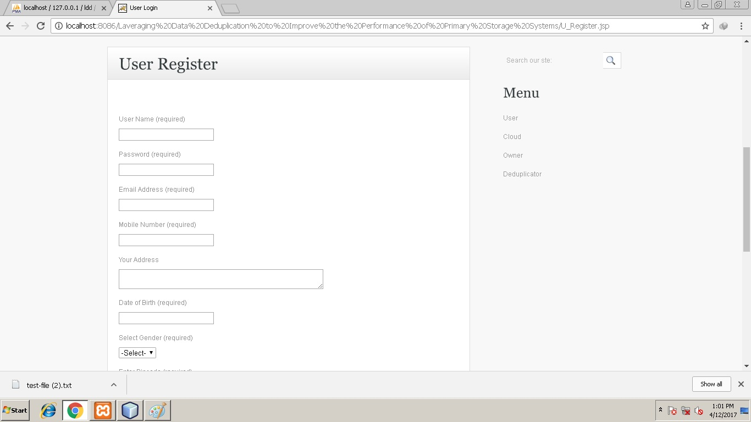

Slide 17
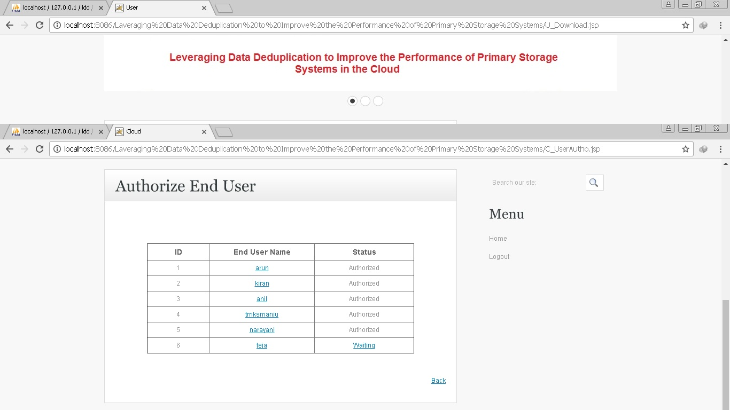

Slide 18
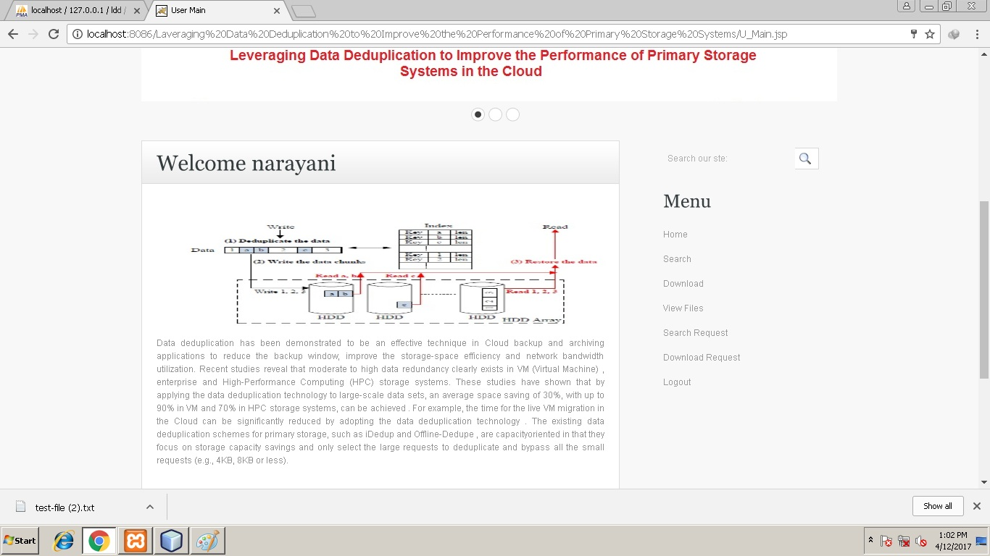

Slide 19
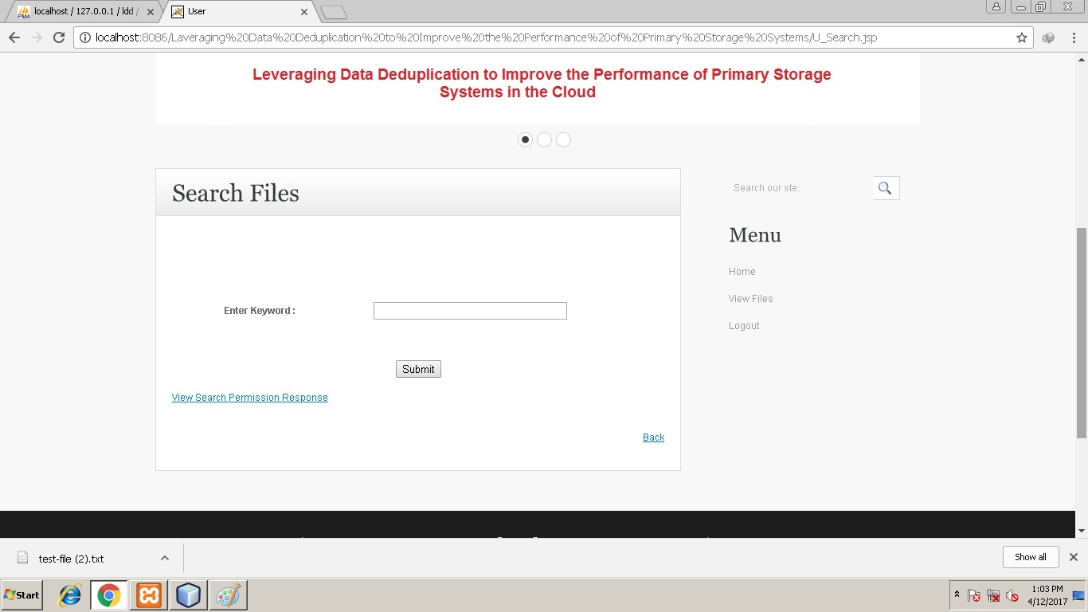

Slide 20
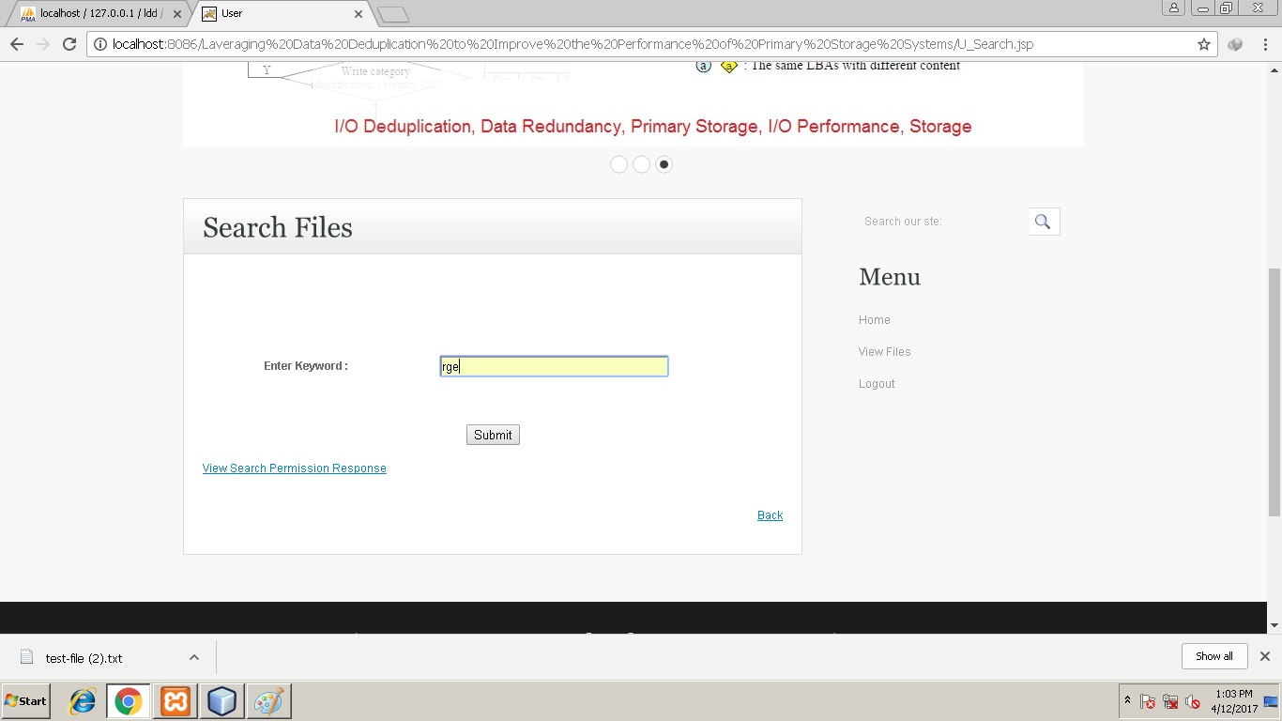

Slide 21
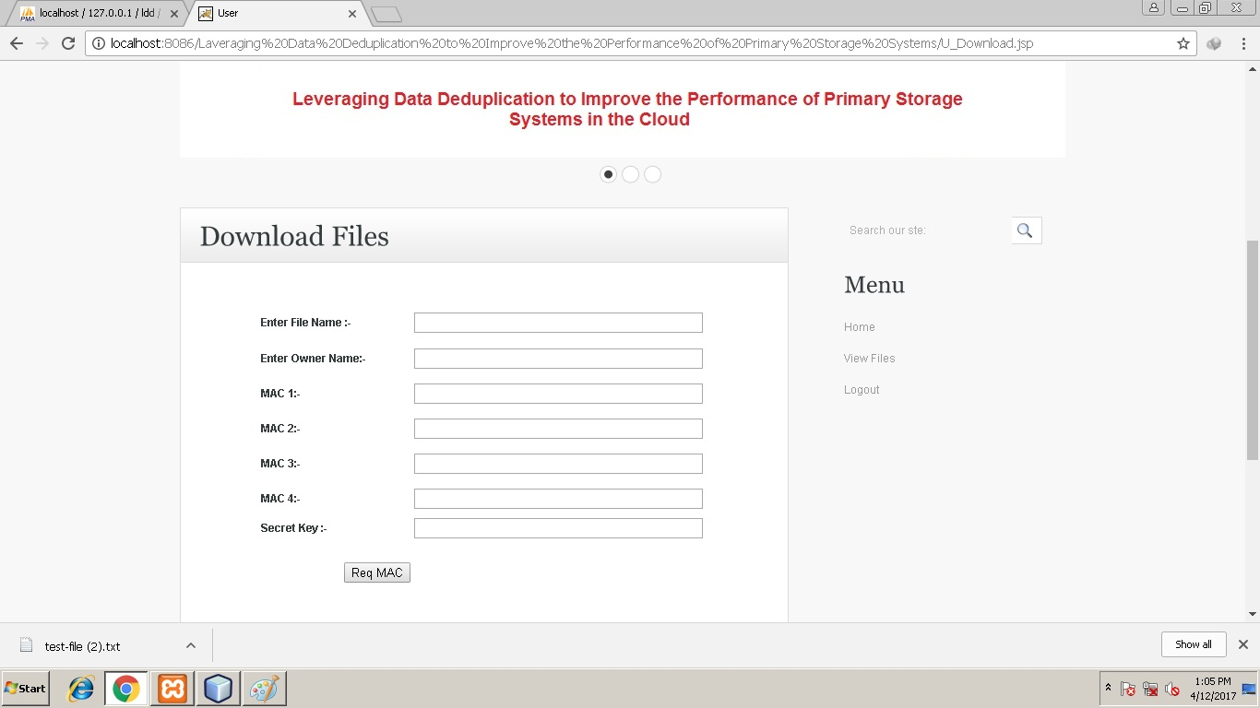

Slide 22
CONCLUSION
In this paper, we propose POD, a performance-oriented deduplication scheme,
to improve the performance of primary storage systems in the Cloud by
leveraging data deduplication on the I/O path to remove redundant write
requests while also saving storage space. By reducing write traffic and saving
storage space, POD has the potential to save the power that disks consume.
We will compare the extra power that CPU consumes for computing
fingerprints with the power that the storage saves, thus systematically
investigating the energy efficiency of POD.

Slide 23
REFERENCES
[1] N. Agrawal, William J. Bolosky, John R. Douceur, and Jacob R. Lorch.
A Five-Year Study of File-System metadata. In FAST’07, Feb. 2007.
[2] A. Anand, S. Sen, A. Krioukov, F. Popovici, A. Akella, Andrea C.
Arpaci-Dusseau, Remzi H. Arpaci-Dusseau, and S. Banerjee.
Avoiding File System Micromanagement with Range Writes.
In OSDI’08, Dec. 2008.
IEEE Transactions on Computers,Volume:65,Issue:6,Issue Date :June.1.2016 14
[3] A. Batsakis, R. Burns, A. Kanevsky, J. Lentini, and T. Talpey.
AWOL: An Adaptive Write Optimizations Layer. In FAST’08, Feb. 2008.

Slide 24


